Slide 1
Principles of Database Systems (CS307) Lecture 15: Advanced Topics
Ran Cheng
Department of Computer Science and Engineering
Southern University of Science and Technology
Most contents are from slides made by Stéphane Faroult, Dr Yuxin Ma and the authors of Database System Concepts (7th Edition).
Their original slides have been modified to adapt to the schedule of CS307 at SUSTech.
Notes:
In this chapter, I will introduce how to retrieve data from one table. Just from one table. I will introduce how to retrieve data from multiple table in next chapter.

Slide 2
Beyond Tables: More Data Types

Slide 3
Semi-Structured Data
Many applications require storage of complex data, whose schema changes often
The relational model’s requirement of atomic data types may be an overkill
E.g., storing set of interests as a set-valued attribute of a user profile may be simpler than normalizing it
Data exchange can benefit greatly from semi-structured data
Exchange can be between applications, or between back-end and front-end of an application
Web-services are widely used today, with complex data fetched to the front-end and displayed using a mobile app or JavaScript
JSON and XML are widely used semi-structured data models

Slide 4
Features of Semi-Structured Data Models
Flexible schema
Wide column representation: allow each tuple to have a different set of attributes, can add new attributes at any time
Sparse column representation: schema has a fixed but large set of attributes, by each tuple may store only a subset

Slide 5
Features of Semi-Structured Data Models
Multivalued data types
Sets, multisets
E.g.,: set of interests: {‘basketball, ‘cooking’, ‘anime’, ‘jazz’}
Key-value map (or just map for short)
Store a set of key-value pairs
E.g.,
{(brand, Apple), (ID, MacBook Air), (size, 13), (color, silver)}
Operations on maps
put(key, value)
get(key)
delete(key)

Slide 6
Features of Semi-Structured Data Models
Arrays
Widely used for scientific and monitoring applications
E.g., readings taken at regular intervals can be represented as array of values instead of (time, value) pairs
[5, 8, 9, 11] instead of {(1,5), (2, 8), (3, 9), (4, 11)}
Array database: a database that provides specialized support for arrays
E.g., compressed storage, query language extensions, etc.
Oracle GeoRaster, PostGIS, SciDB, etc

Slide 7
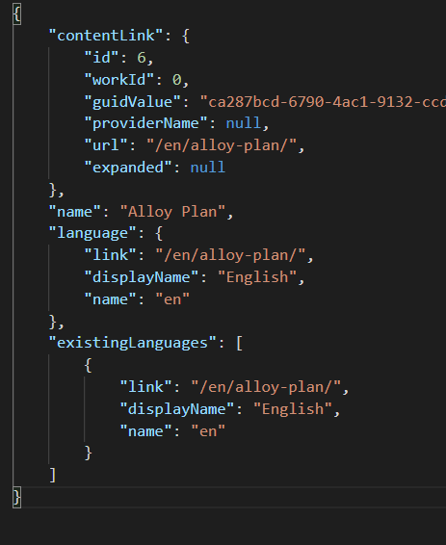
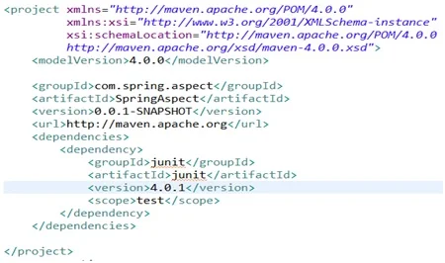
Nested Data Types
Hierarchical data is common in many applications
JSON (JavaScript Object Notation)
Widely used today
XML (eXtensible Markup Language)
Earlier generation notation, still used extensively

Slide 8
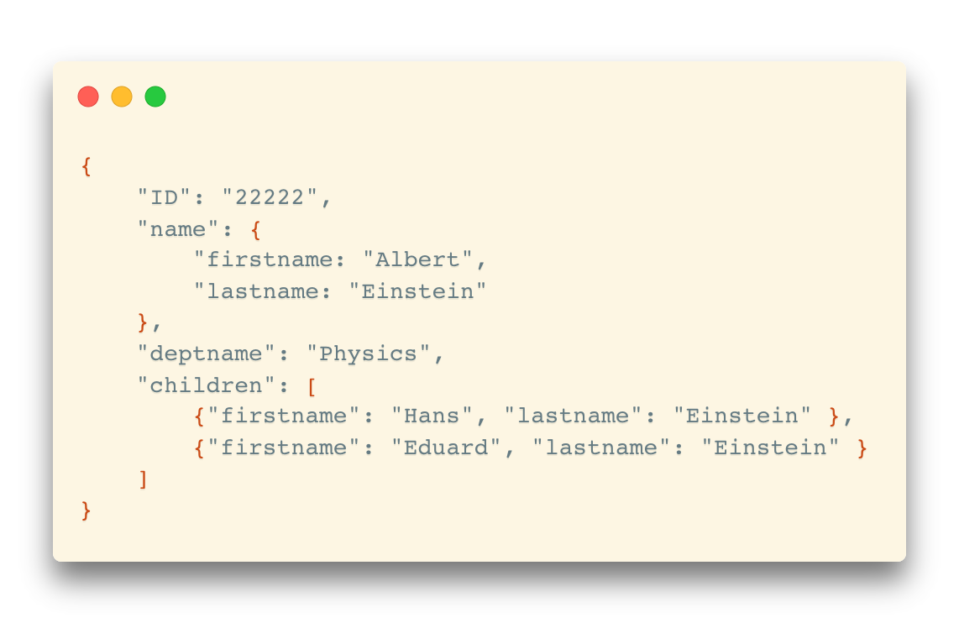
JSON
Textual representation widely used for data exchange
Types: integer, real, string, and
Objects: key-value maps, i.e. sets of (attribute name, value) pairs
Arrays: also key-value maps (from offset to value)

Slide 9
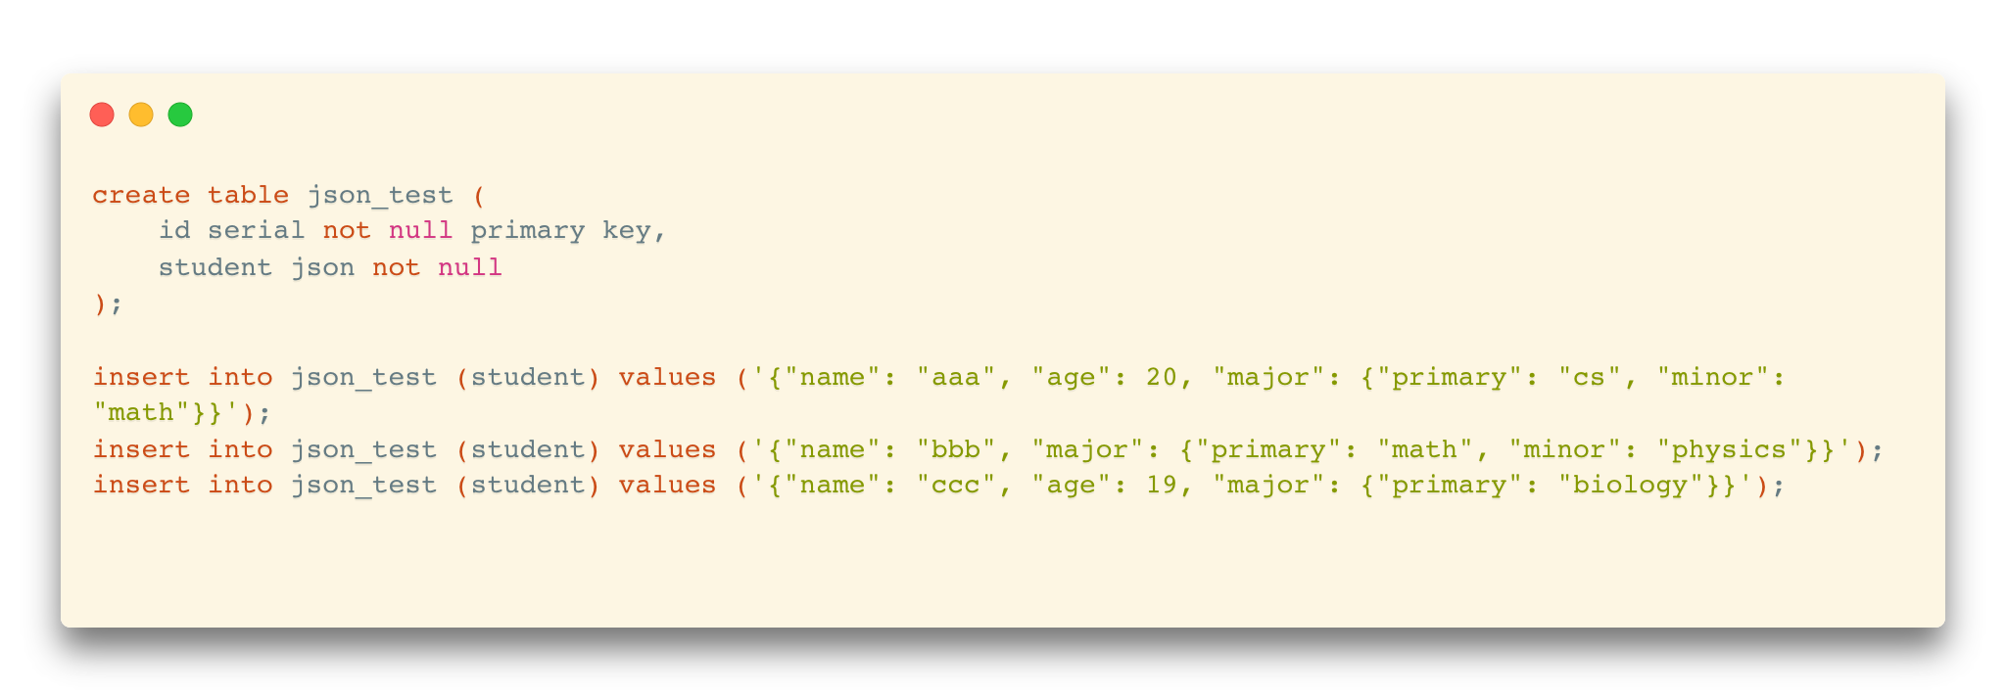
JSON
JSON is ubiquitous in data exchange today
Widely used for web services
Most modern applications are architected around on web services
PostgreSQL supports JSON format columns

Slide 10
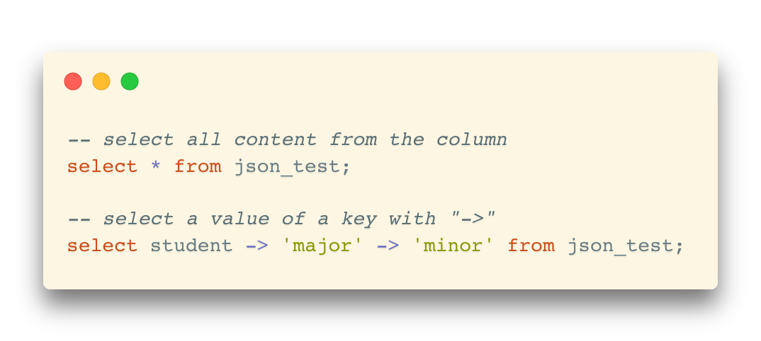
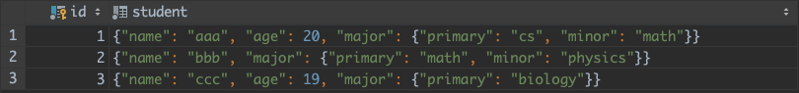
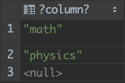
JSON
JSON is ubiquitous in data exchange today
Widely used for web services
Most modern applications are architected around on web services
PostgreSQL supports JSON format columns

Slide 11
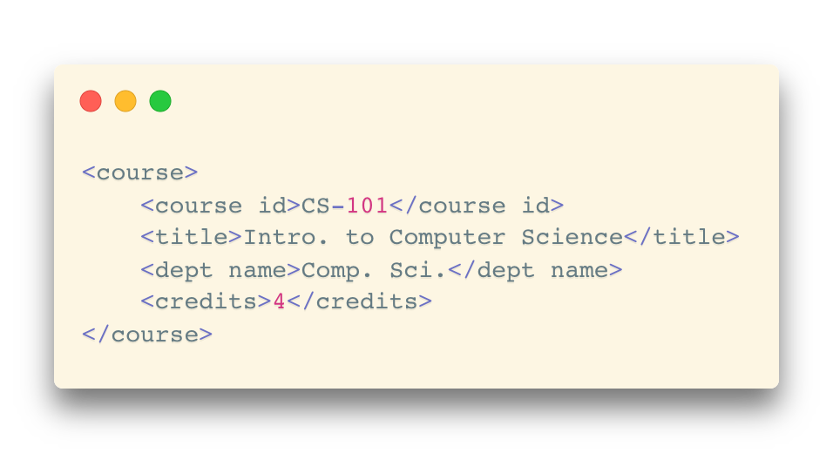
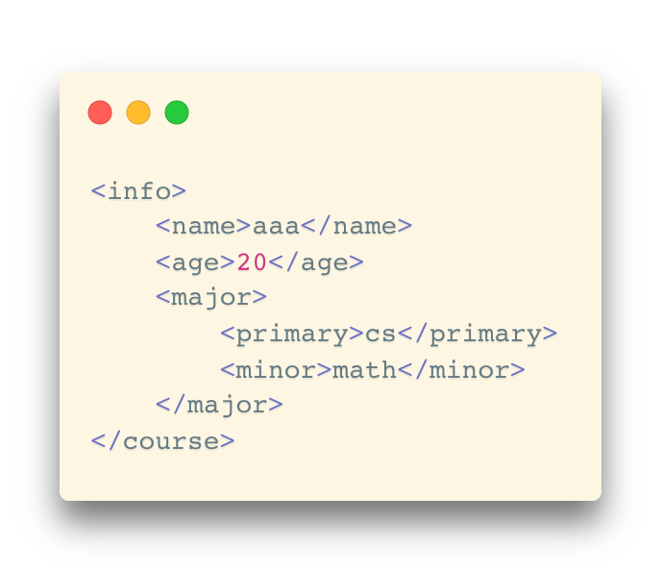
XML
XML uses tags to mark up text
Tags make the data self-documenting
Tags can be hierarchical

Slide 12
Textual Data
Information retrieval: querying of unstructured data
Simple model of keyword queries: given query keywords, retrieve documents containing all the keywords
More advanced models rank relevance of documents
Today, keyword queries return many types of information as answers
E.g., a query “cricket” typically returns information about ongoing cricket matches
Relevance ranking
Essential since there are usually many documents matching keywords

Slide 13
Spatial Data
Spatial databases store information related to spatial locations, and support efficient storage, indexing and querying of spatial data.
Geographic data: road maps, land-usage maps, topographic elevation maps, political maps showing boundaries, land-ownership maps, and so on.
Geographic information systems (GIS) are special-purpose databases tailored for storing geographic data.
Round-earth coordinate system may be used
(Latitude, longitude, elevation)
Geometric data: design information about how objects are constructed
E.g., designs of buildings, aircraft, layouts of integrated-circuits.
2 or 3 dimensional Euclidean space with (X, Y, Z) coordinates

Slide 14
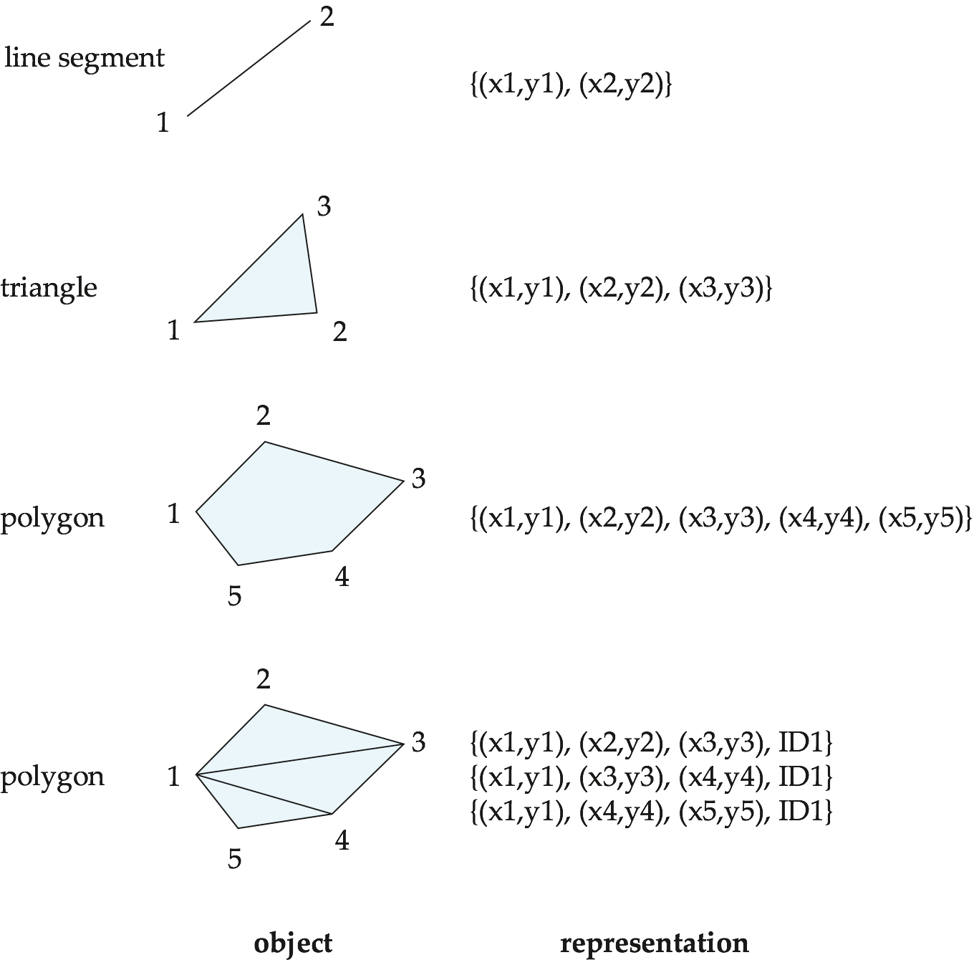
Representation of Geometric Information
Various geometric constructs can be represented in a database in a normalized fashion

Slide 15
Representation of Geometric Information
Representation of points and line segment in 3-D similar to 2-D, except that points have an extra “z” component
Represent arbitrary polyhedra by dividing them into tetrahedrons
Similar to triangulating polygons
Alternative
List their faces, each of which is a polygon, along with an indication of which side of the face is inside the polyhedron

Slide 16
Representation of Geometric Information
Geometry and geography data types supported by many databases
E.g. PostGIS
point, linestring, curve, polygons
Collections: multipoint, multilinestring, multicurve, multipolygon
LINESTRING(1 1, 2 3, 4 4)
POLYGON((1 1, 2 3, 4 4, 1 1))
Type conversions: ST GeometryFromText() and ST GeographyFromText()
Operations: ST Union(), ST Intersection(), …

Slide 17




NoSQL Database
“Not Only SQL”
Useful when working with a huge quantity of data when nature of data does not require a relational model
Usually not built on tables and queried by SQL
Examples
Document store – MongoDB
Graph structure – Neo4j
Key-value storage – Redis, LevelDB
Tabular – Apache Hbase (Hadoop-based)

Slide 18
Beyond Storage: Big Data Analytics

Slide 19
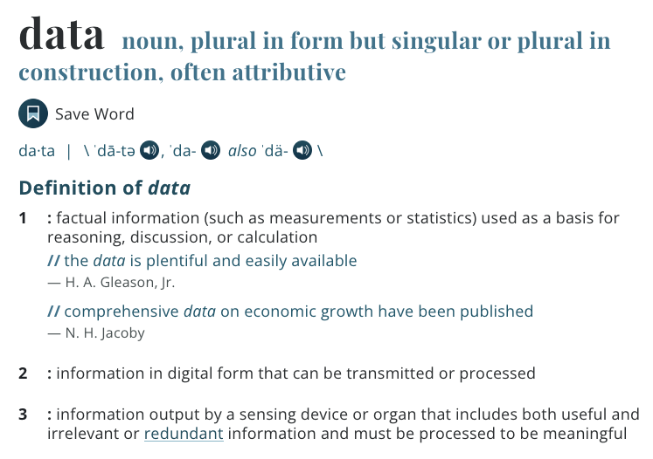
What is Data, By the Way?
factual information (such as measurements or statistics) used as a basis for reasoning, discussion, or calculation
https://www.merriam-webster.com/dictionary/data

Slide 20
Data Attribute
Characteristics or feature of a data object
Other names:
Feature
Dimension
Variable
Set of attributes: attribute vector

Slide 21

Attribute Types
Nominal (Categorical) attribute
Ordinal attribute
Extra-Small
Small
Medium
Large
Extra-Large

Slide 22

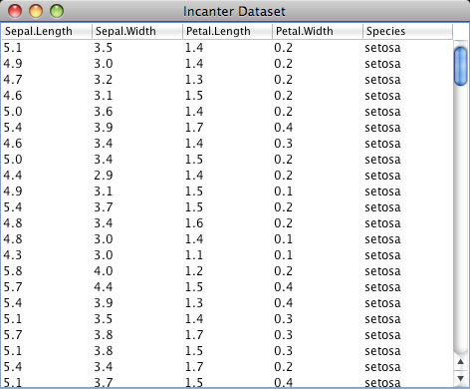
Attribute Types
Numeric attribute
https://archive.ics.uci.edu/ml/datasets/iris

Slide 23
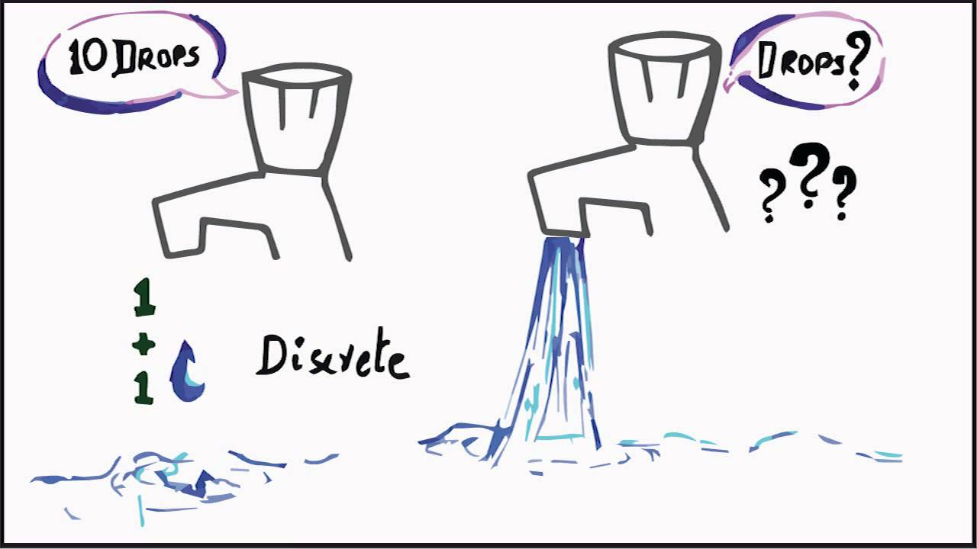
Discrete vs. Continuous

Slide 24
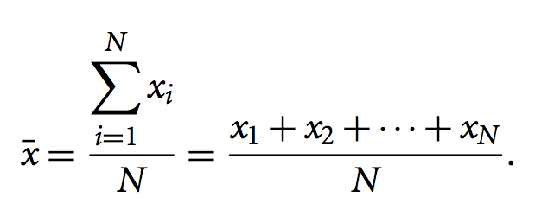
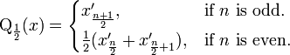
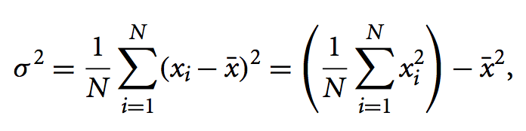
Basic Statistical Descriptions
Overall picture of your data
Basis of exploratory data analysis
Mean
Median
Variance

Slide 25
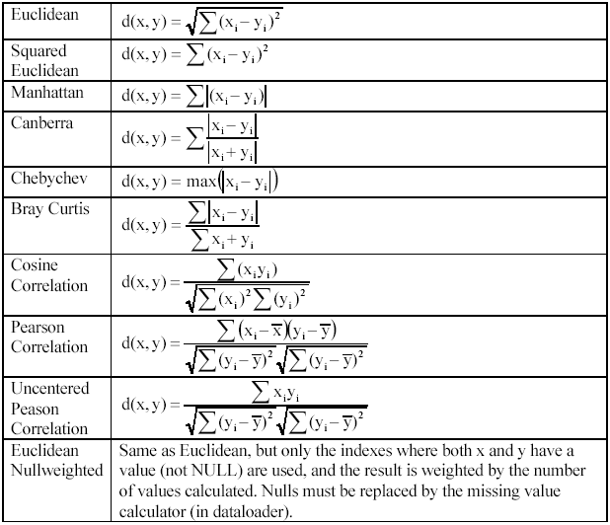
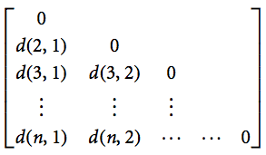
Relationship between Data Objects: Data (Dis)Similarity
Measurement of relationships
Commonly used in many statistical methods and data mining algorithms
Dissimilarity Matrix & Distance Measures

Slide 26
What is Big Data?
A collection of data sets so large and complex

Slide 27
Three Dimensions of Big Data
Volume
From GB to TB, PB, or higher
Velocity
Processing speed
Variety
Text, sensor data, multimedia, …
Other (new) aspects:
Veracity: Trustworthiness
Value: Worth of data

Slide 28
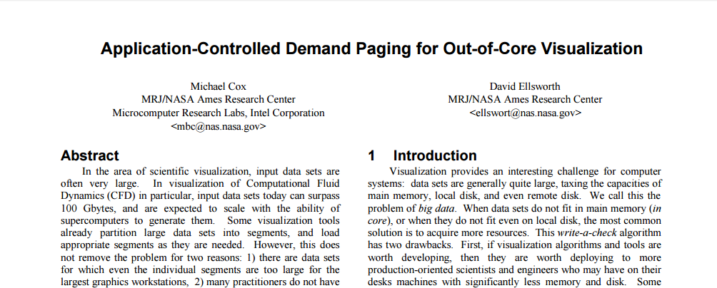
The Emergence of Data Science
1997: The first article to use the term “big data” in the ACM digital library.
Proceedings of the Visualization ‘97

Slide 29
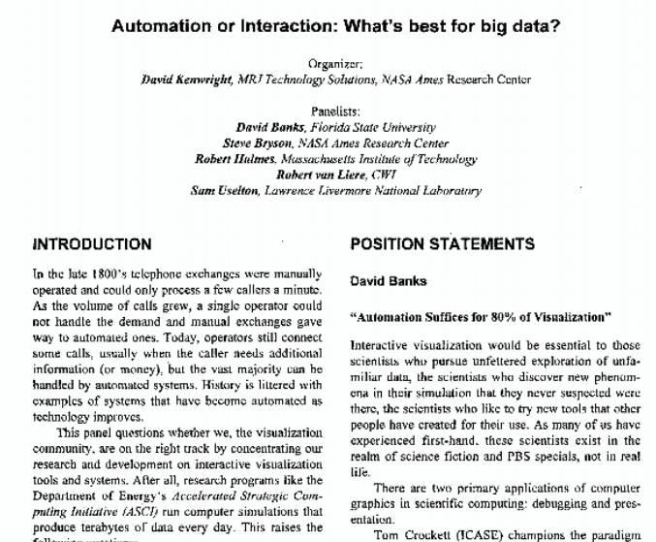
The Emergence of Data Science
1999: Bryson, Kenwright and Haimes join David Banks, Robert van Liere, and Sam Uselton on a panel titled “Automation or interaction: what’s best for big data?” at the IEEE Conference on Visualization in 1999
Proceedings of the IEEE Conference on Visualization in 1999

Slide 30
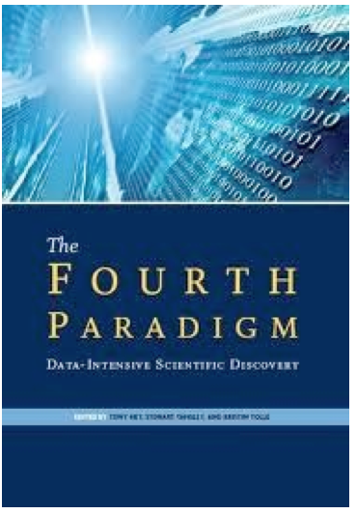
The Emergence of Data Science
2007: “The Fourth Paradigm”
“Data-Intensive Scientific Discovery”
Notes:
2007年1月，图灵奖得主、关系数据库的鼻祖Jim Gray在海上消失。留下了一份遗产：The Fourth Paradigm: Data-Intensive Scientific Discovery（《第四范式：数据密集型科学发现》）[1]
《第四范式》是基于Jim Gray生前最后一次演讲稿整理而成。在这次演讲中，Jim Gray将人类科学的发展定义成为四个“范式”，并描绘了自己关于第四范式的愿景：
几千年前的科学，以记录和描述自然现象为主，称为“实验科学”，即第一范式，其典型案例如钻木取火；
数百年前，科学家们开始利用模型归纳总结过去记录的现象，发展出“理论科学”，即第二范式，其典型案例如牛顿三定律、麦克斯韦方程组、相对论等；
过去数十年，科学计算机的出现，诞生了“计算科学”，对复杂现象进行模拟仿真，推演出越来越多复杂的现象，其典型案例如模拟核试验、天气预报等；
Jim Gray认为今天，以及未来科学的发展趋势是，随着数据量的高速增长，计算机将不仅仅能做模拟仿真，还能进行分析总结，得到理论。也就是说，过去由牛顿、爱因斯坦等科学家从事的工作，未来可以由计算机来做。Jim Gray将这种科学研究的方式，称为第四范式，即数据密集型科学。

Slide 31

The Emergence of Data Science
2012: Data Scientist: The Sexiest Job of the 21st Century

Slide 32
The Emergence of Data Science
2013: The IEEE Task Force on Data Science and Advanced Analytics was launched.
2014: The first international conference: IEEE International Conference on Data Science and Advanced Analytics was launched.
2015: The International Journal on Data Science and Analytics was launched by Springer to publish original work on data science and big data analytics.
2016: The American Statistical Association section on Statistical Learning and Data Mining renamed to "Statistical Learning and Data Science".

Slide 33
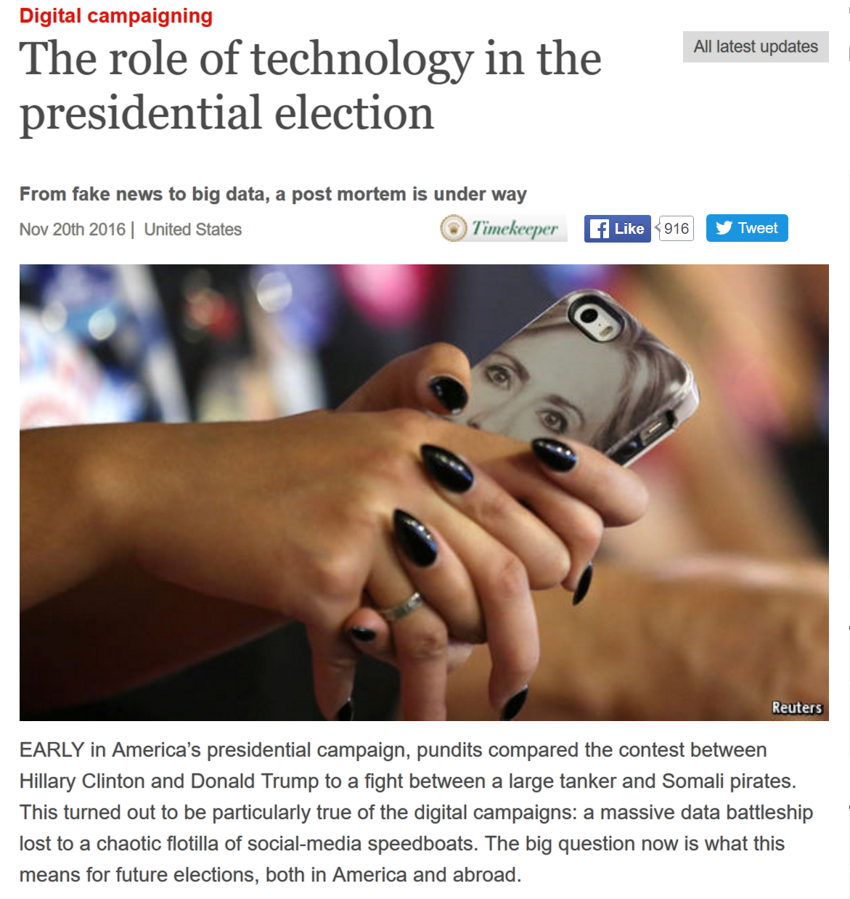
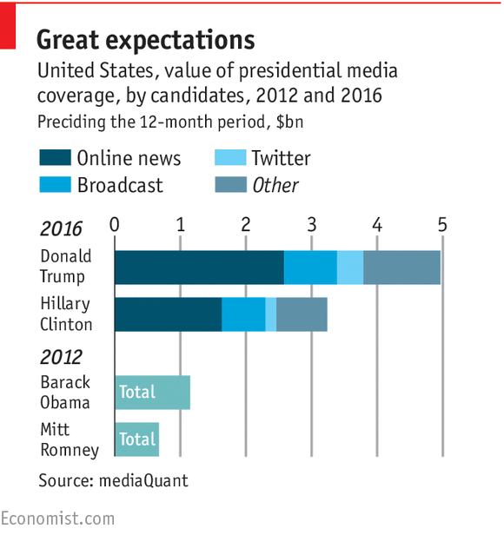
The Emergence of Data Science
2016: “Trump vs. Clinton: How Big Data and scientists helped Trump win the election”

Slide 34


Standard Architecture
Application
Database
Data Products
Data
Warehouse
ETL
(Extract, Transform, Load)
Business Intelligence
Analytics

Slide 35
Instantiations(1) - Businesspersons
Data Sources
Web pages
Excel
Extract-Transform-Load (ETL)
Copy & paste
Data Warehouse
Excel
BI and Analytics
Excel functions
Excel charts
VB scripts?
Visualization tools: Power BI, Tableau

Slide 36
Instantiations(2) - Programmers
Data Sources
Web scraping, web services API
CSV files
Database queries
ETL
wget, curl, Beautiful Soup, lxml, …
Data Warehouse
Files
Analytics
Numpy, pandas, Matplotlib, R, Octave, …

Slide 37
Instantiations(3) - Enterprises
Data Sources
Application databases(Oracle, IBM, …)
Intranet files
Application log files
ETL
Infomatica, IBM DataStage, …
Data Warehouse
Teradata, Oracle, IBM DB2, …
Business Intelligence & Analytics
SAS, SPSS, R, …
Power BI, Tableau, Spotfire, …

Slide 38
Instantiations(4) – Web Companies
Data Sources
Application databases
Logs
Web crawl data
ETL
Apache Flume, Apache Sqoop, …
Data Warehouse
Hadoop-based: Hive, Hbase
Microsoft Azure, Amazon Redshift
Business Intelligence & Analytics
Argus, R, …

Slide 39
ETL: What is Inside
Data Cleaning
Data Integration

Slide 40
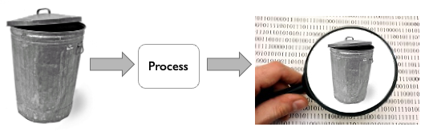
“Garbage in, garbage out.”
Raw data can always be DIRTY!

Slide 41
Data Quality
Data quality: data has quality if it satisfies the requirements of its intended use
Accuracy
Completeness
Consistency
Timeliness
Believability
Interpretability

Slide 42
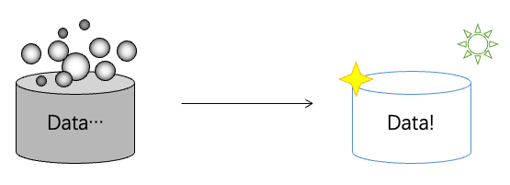
Data Cleaning
Deals with detecting and removing errors and inconsistencies from data in order to improve the quality of data

Slide 43
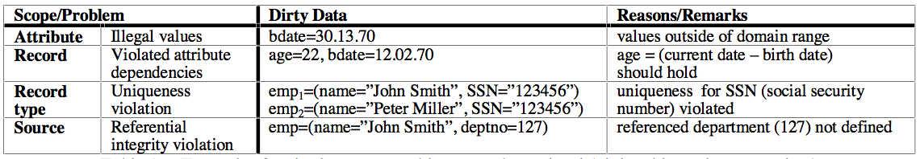
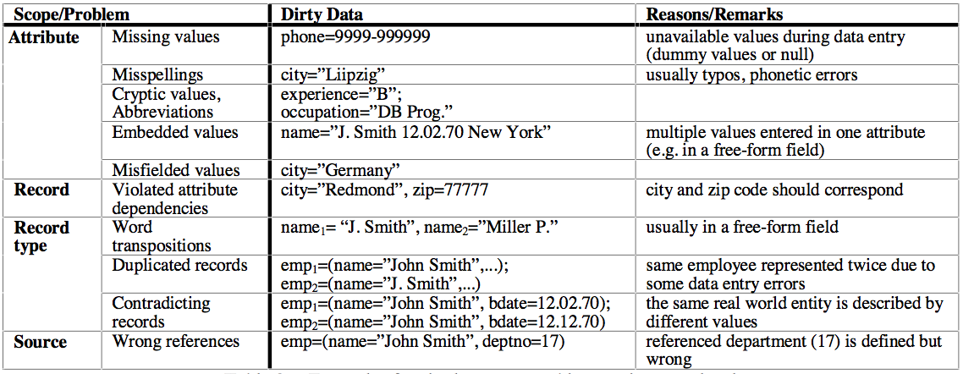
Data Cleaning
Examples of data quality issues
Schema-level
Instance-level

Slide 44
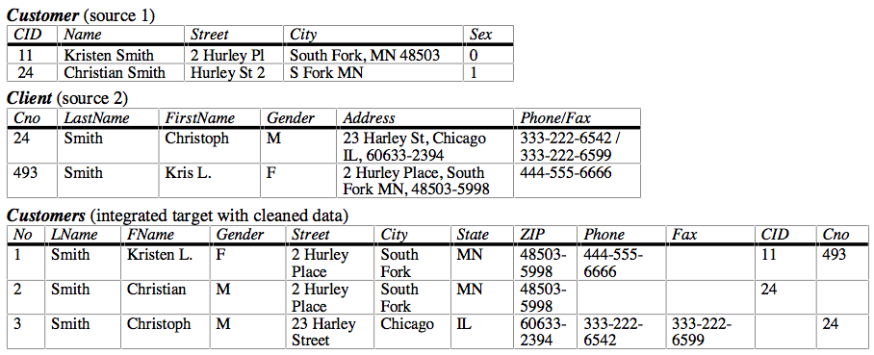
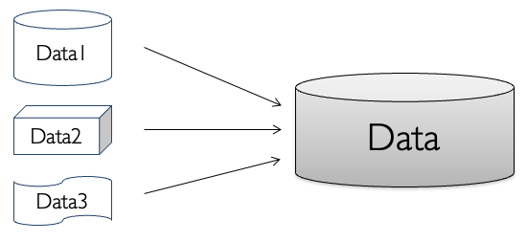
Data Integration
Data integration involves combining data residing in different sources and providing users with a unified view of these data.
Remember “views” in DBMS?
Management of data from multiple sources

Slide 45
Typical Data Cleaning and Integration Workflow
Data analysis
Detailed inspection before operations
Conflicts resolution
Resolve data confliction between data sources to be integrated
Definition of transformation workflow and mapping rules
Workflow methods for schema adaption and transformation
Verification of Workflow
Verify each steps
Transformation
start the process

Slide 46
Load and Store Data
File-based Storage
Simplest way & easy to manage
Scalability is low
Database & DBMS
What we have learned for 10+ weeks
Data Warehouse

Slide 47
Data Warehouse
A data warehouse is a subject-oriented, integrated, time-varient, and nonvolatile collection of data in support of management’s decision making process.
-- W. H. Inmon, “Building the Data Warehouse”. 1996.
Loosely Speaking, a data warehouse refers to a data repository that is maintained separately from an organization’s operational databases.
-- J. Han and M. Kamber, “Data Mining: Concepts and Techniques”, 3rd ed., 2011.

Slide 48
Differences between Databases and Data Warehouses
 | DB | DW
Characteristics | operational processing | Informational processing
Orientation | transaction | analysis
User | terminal users: clerk, database administrator(DBA) | knowledge workers: manager, analyst, executive
Function | everyday operations | long-term informational requirements decision support
Data | current, up-to-date | historic, accuracy maintained over time
Access | read/write | mostly read
Focus | data in | information/knowledge out
Size | GB to high-order GB | >=TB

Slide 49
Data Analysis
Exploratory Data Analysis
Data Mining

Slide 50
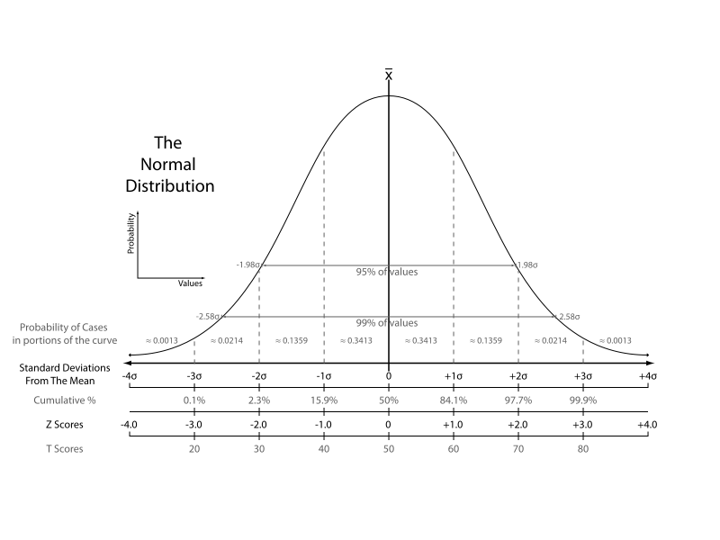
Something Basic: Statistics
(Probably) Foundation of modern data analysis
(Also) Foundation of machine learning, data mining, etc.

Slide 51
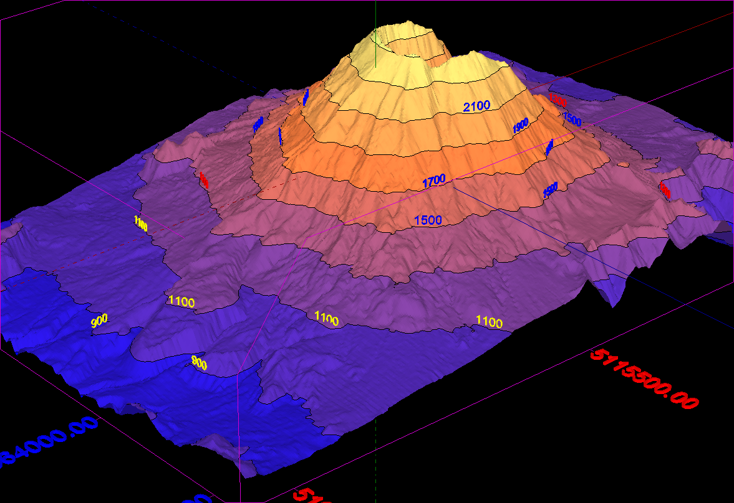
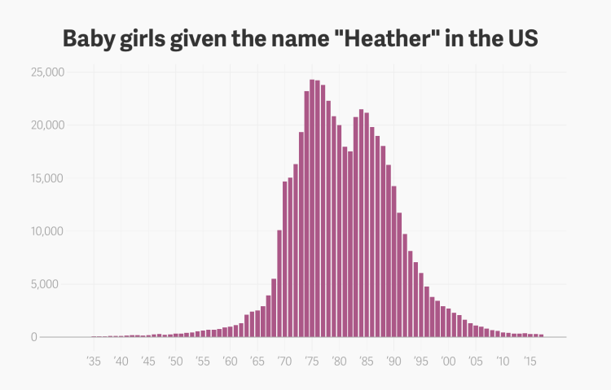
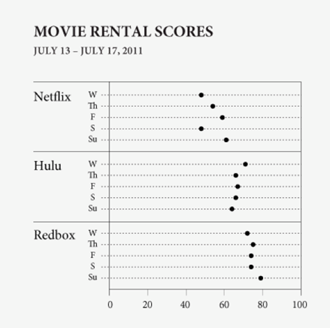
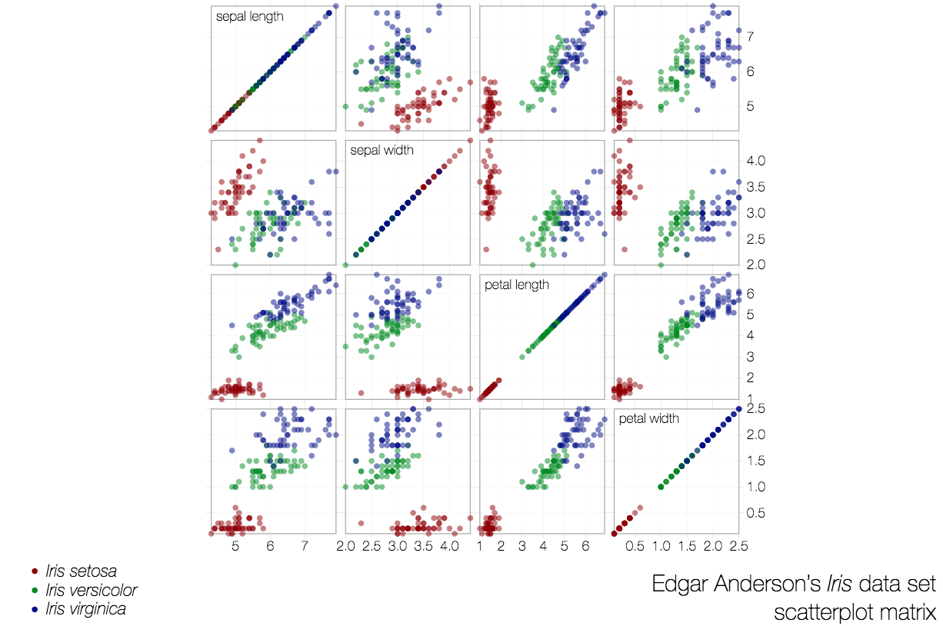
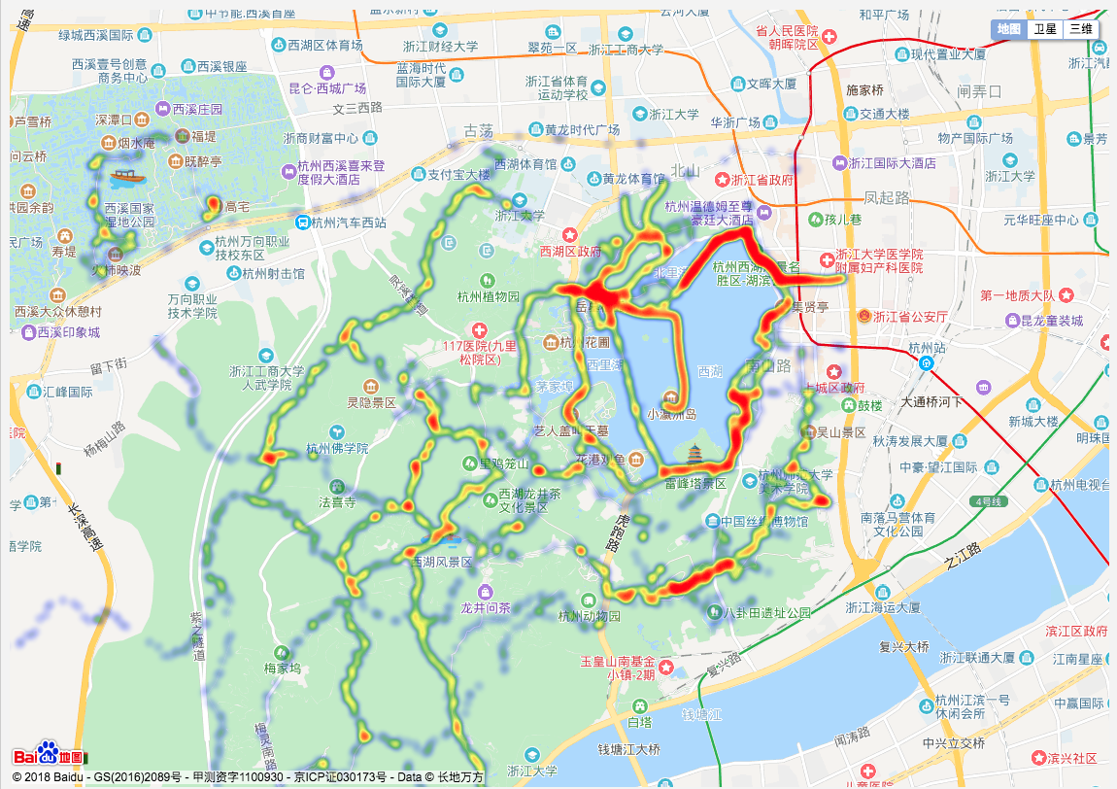
Exploratory Data Analysis (EDA)
Based on statistics
Data visualization-driven method
Summary of main characteristics in easy-to-understand form
Types of data visualization methods in EDA:
Plotting of raw data
Plotting of statistical values
Multiple coordinated views (Dashboard)

Slide 52

Exploratory Data Analysis (EDA)
“Some of my friends felt that I should be very explicit in warning you of how much time and money can be wasted on computing, how much clarity and insight can be lost in great stacks of computer output. In fact, I ask you to remember only two points:
The tool that is so dull that you cannot cut yourself on it is not likely to be sharp enough to be either useful or helpful.
Most uses of the classical tools of statistics have been, are, and will be , made by those who know not what they do.”
-- John W. Tukey, “The Technical Tools of Statistics”,
at the 125th Anniversary Meeting of American Statistical Association, 1964

Slide 53
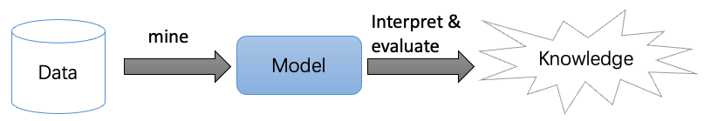
Data Mining
“Data Mining, also popularly referred to as knowledge discovery from data (KDD), is the automated or convenient extraction of patterns representing knowledge implicitly stored or captured in large databases, data warehouses, the Web, other massive repositories, or data streams.”
-- H. Jiawei and M. Kamber, “Data Mining: Concepts and Techniques”, 3rd ed., 2011.

Slide 54
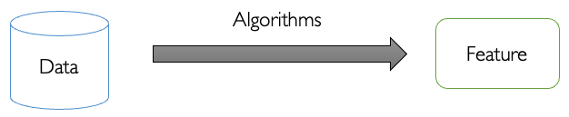
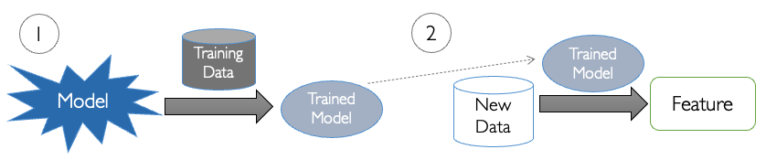
Tasks in Data Mining
Descriptive Tasks
Predictive Tasks

Slide 55
Descriptive Tasks
Concept Description
Describe features of data directly
Association Analysis
Analyze “feature-value” pairs that occur frequently in data
Clustering
Group data on the principle of maximizing the intra-class similarity and minimizing the inter-class similarity
Outlier Detection
Analyze objects that do not comply with the general behavior or model of the data

Slide 56
Predictive Tasks
Regression
Model the relationship between a scalar response and a number of variables
Classification
Find a model/function that describes and distinguish data classes or concepts based on analysis of a set of training data
Evolution Analysis
Analyze temporal and spatial patterns in dataset, model these patterns and predict data in unknown spatio-temporal positions

Slide 57

Data Visualization
Visualization is the creation and study of the visual representation of data
Input: data
Output: visual form
Goal: insight

Slide 58
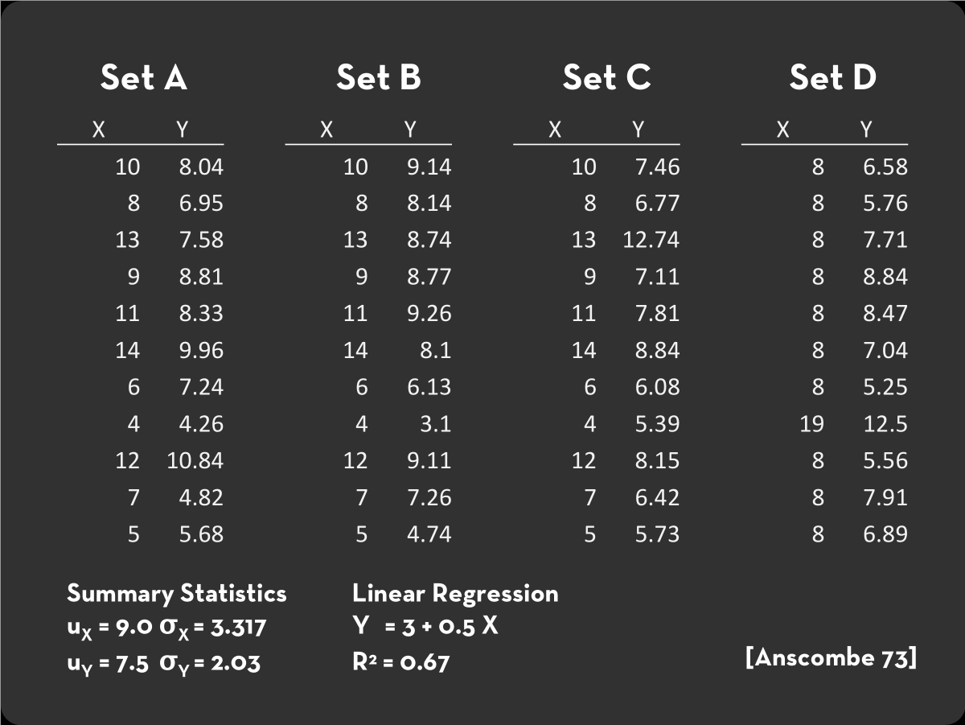
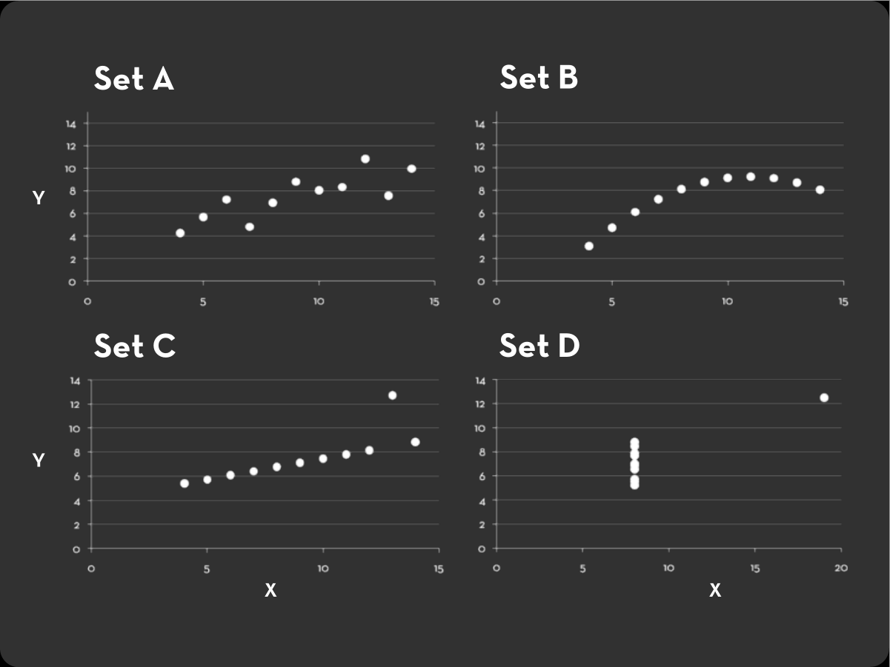
Why Do We Need Visualization?
Sometimes, statistics may not work

